Slide 1

S.O.P –
Measurement

Slide 2

CONTENTS
Tool & Material
(Alat dan Bahan)
2. Flow Chart Measurement
(Alur Pengukuran)

Slide 3
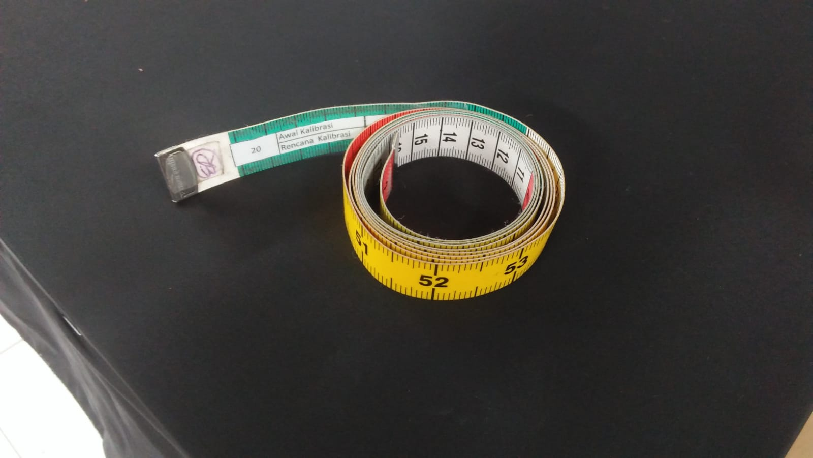
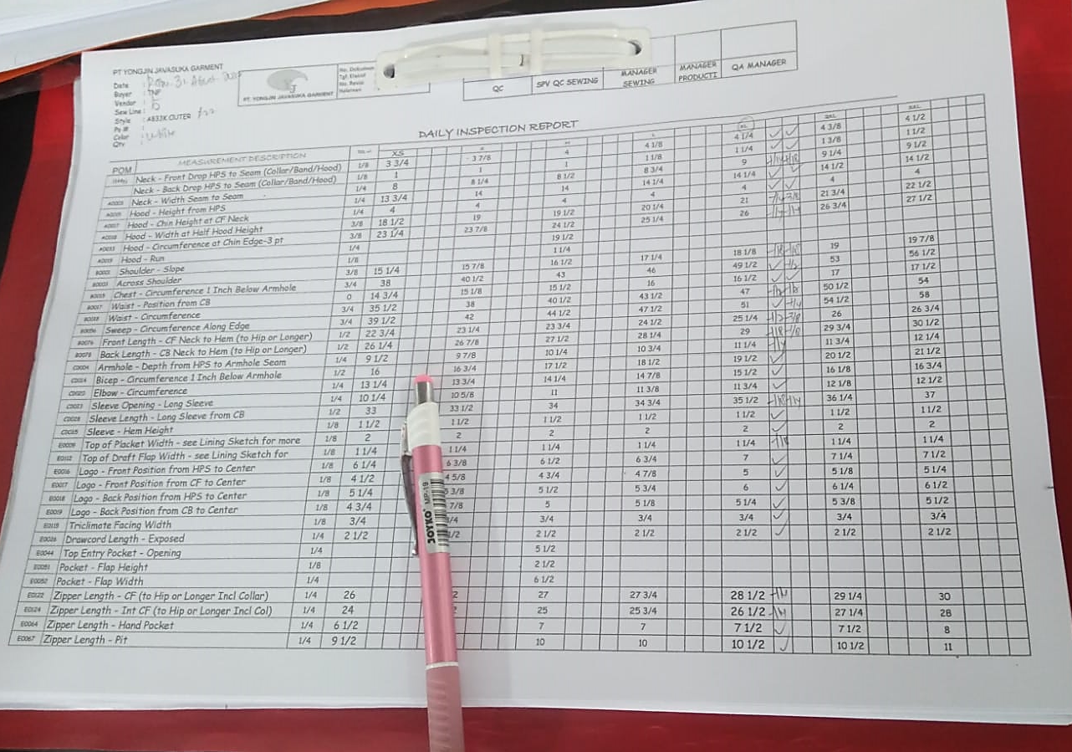
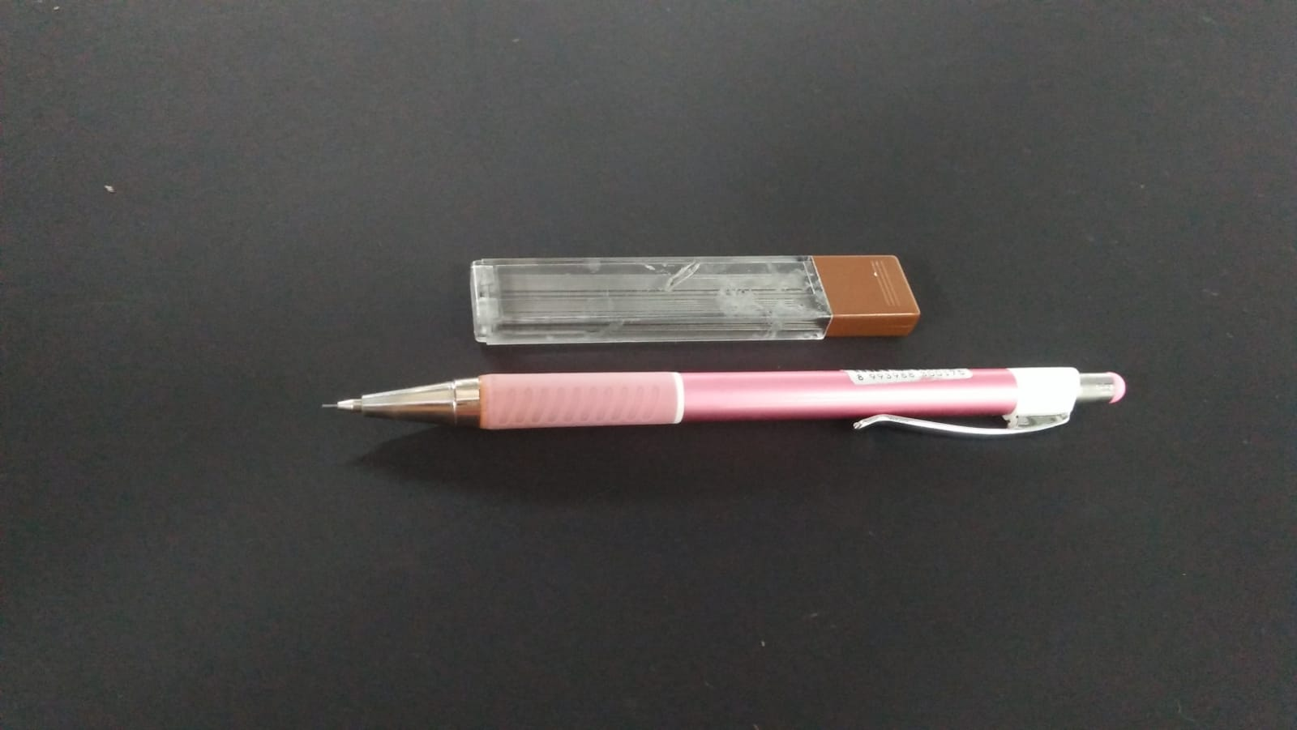
S.O.P Measurement
Tools and Material (alat dan bahan)
Note (catatan):
When measuring, QC check the first output garments from sewing 3 times a day (morning, after lunch & afternoon).
Saat pengukuran, QC memeriksa first output garment dari sewing sekitar 3 kali sehari (pagi, setelah makan siang & sore).
Every one person QC measurement checks 3 lines per-day.
Tiap satu orang QC memeriksa 3 line per hari.
Measurement Tape
Size Speck
Pencil
<Embroidery Alignment Tool, Size Speck Form, Measurement Tape, Refill Pencil>

Slide 4
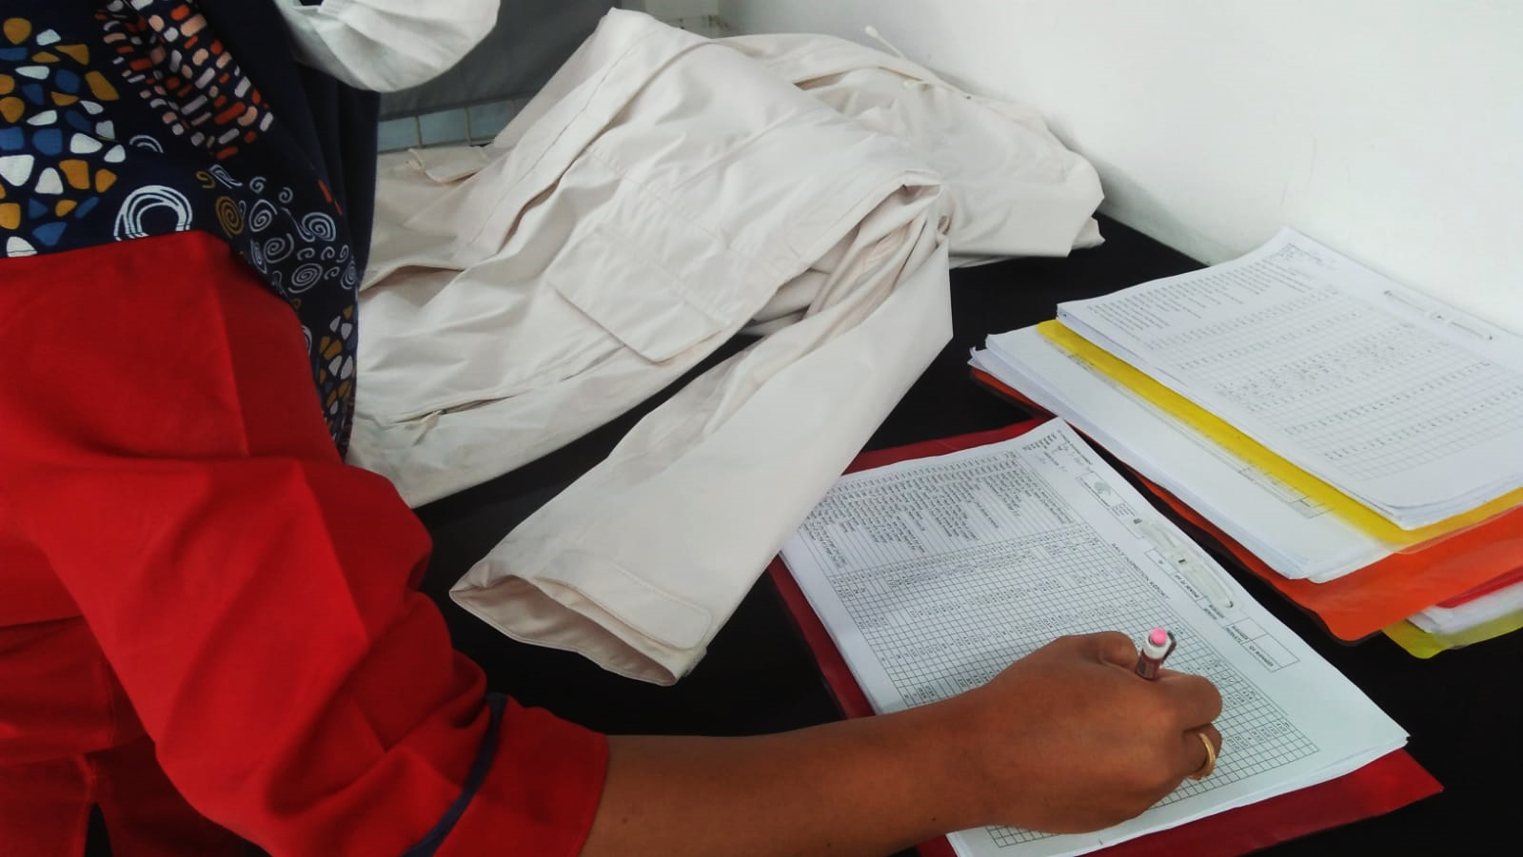
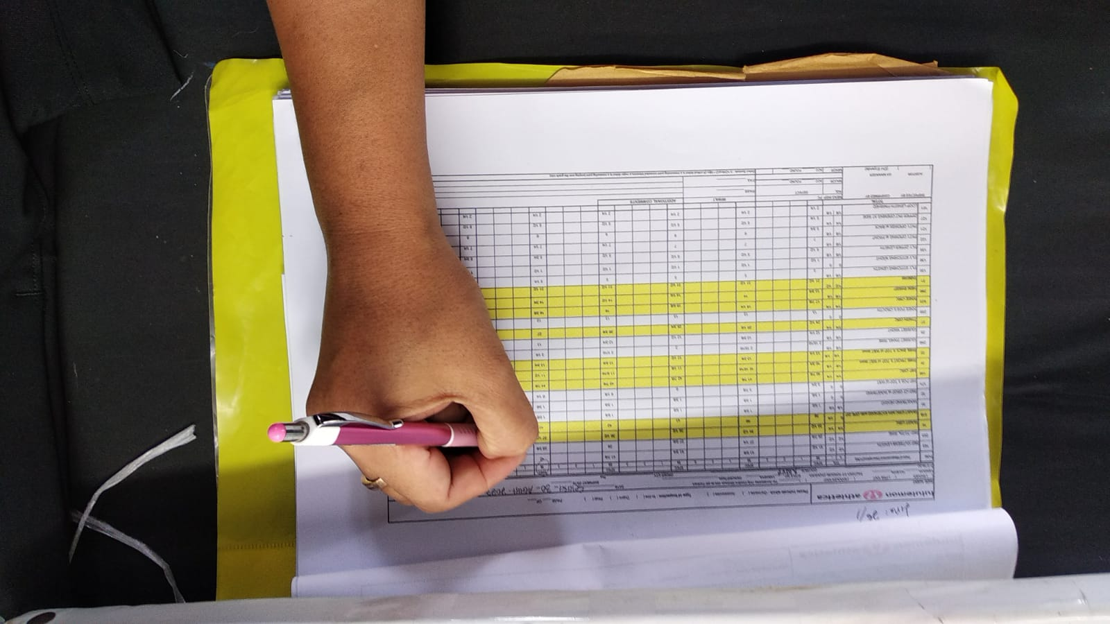
S.O.P Measurement
Flowchart Measurement (alur pengukuran)
Need to be checked the “Size Speck” form
after measuring every garment parts
The “Size Speck” form must be updated regarding to the color & size.
Work Flow Measurement (Cara kerja pengukuran)
  Check the first output from sewing 3 times a day. (Periksa output pertama dari sewing 3 kali sehari)
  Follow the size speck form measurement table (BOM/Bill of Material). (Ikuti standar ukuran yang ada di BOM)
  If it is found the wrong size or size is out of tolerance, then garments should be given reject status and put separately. (Jika ditemukan salah ukuran atau ukuran yang diluar toleransi, maka garment harus diberikan status “reject” dan diletakkan terpisah)
  The QC measurement disscuss with the QC supervisor and then briefing with chief and all related manager for repairing the garment. (QC yang mengukur diskusi dengan supervisor QC lalu ”briefing” dengan chief dan seluruh manager yang bertanggung jawab untuk memperbaiki garment)

Slide 5
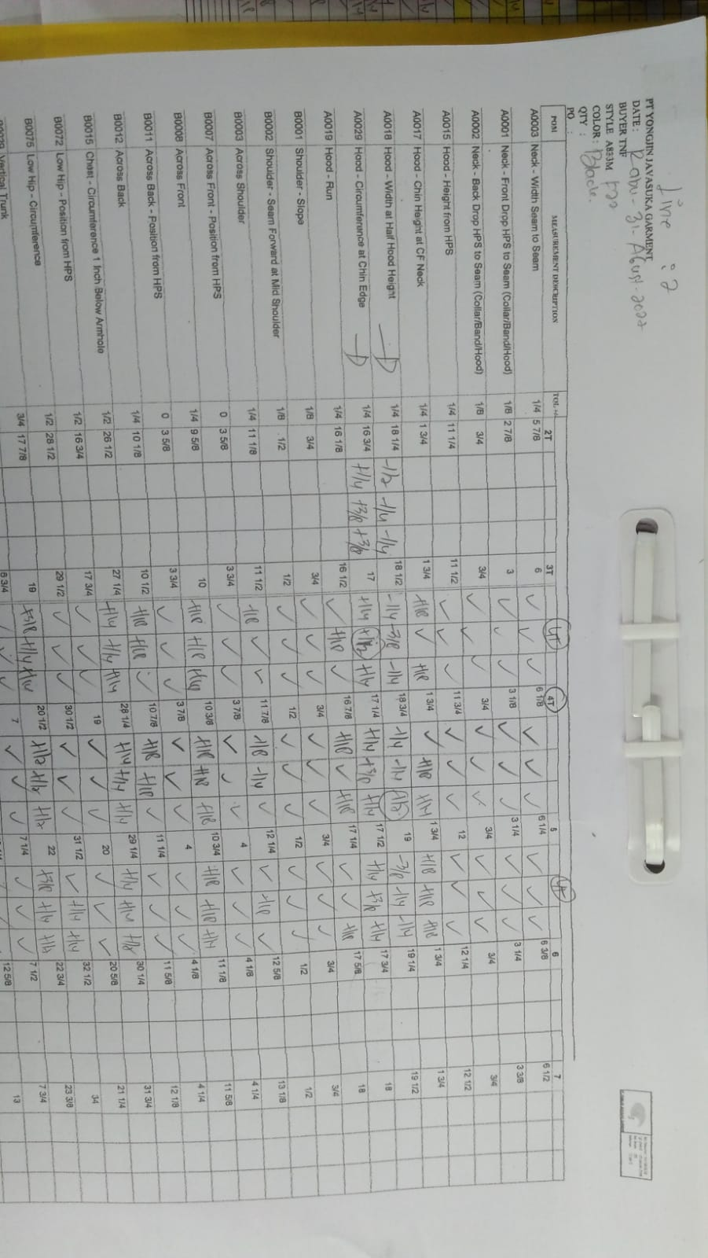
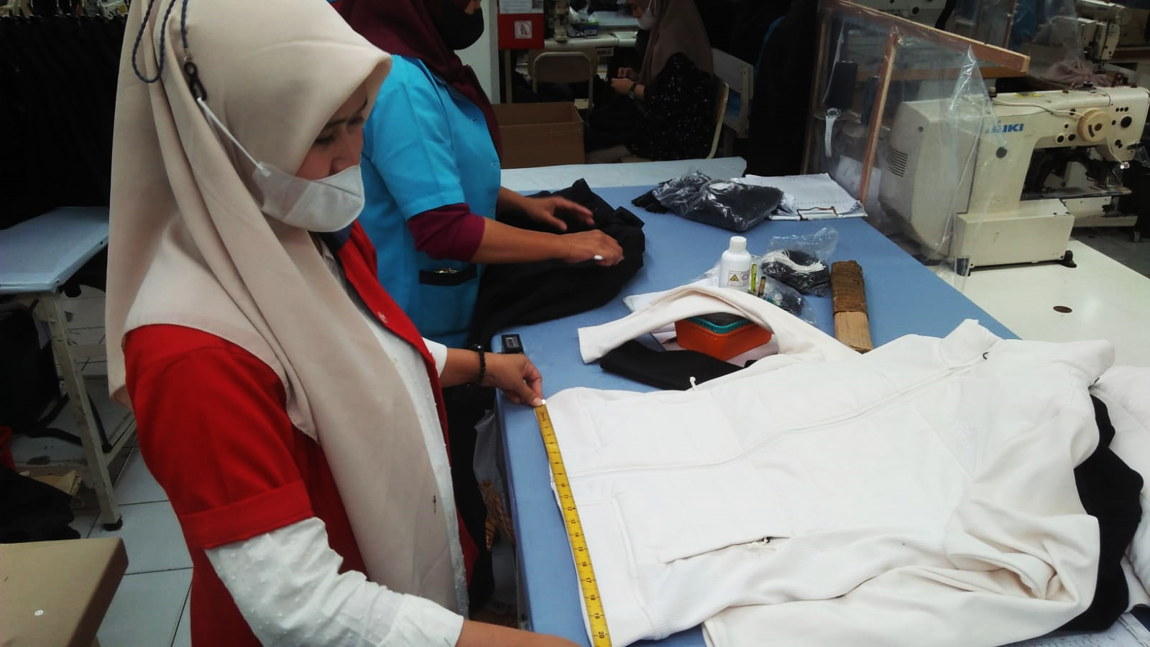
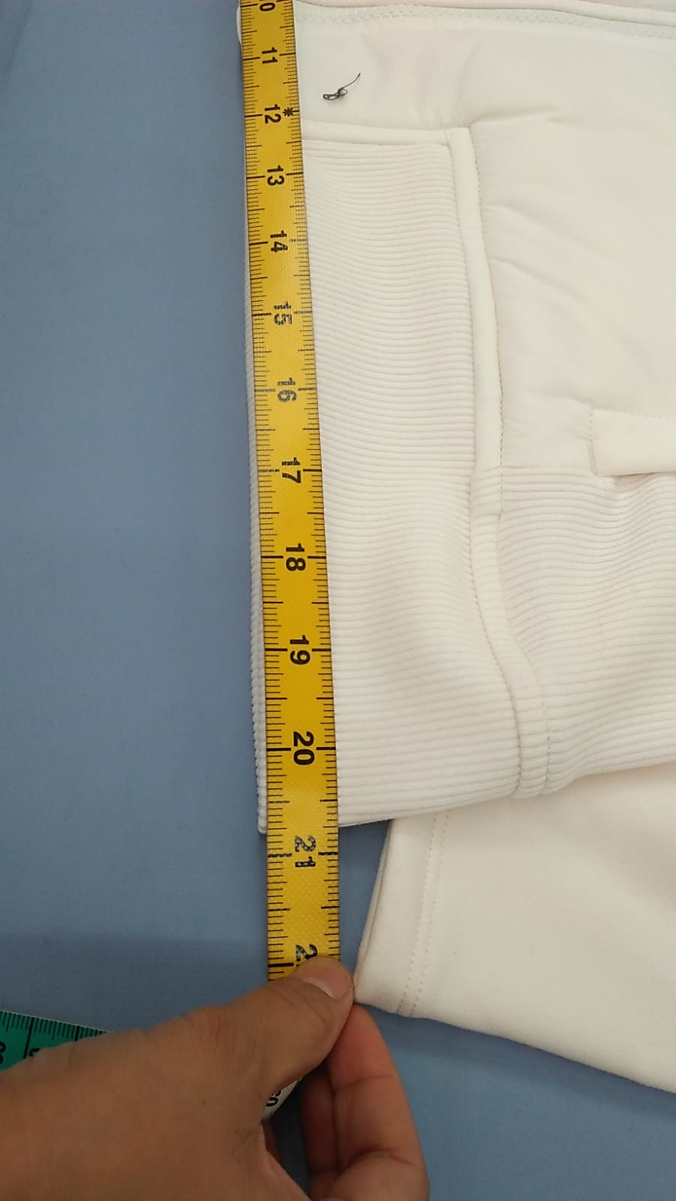
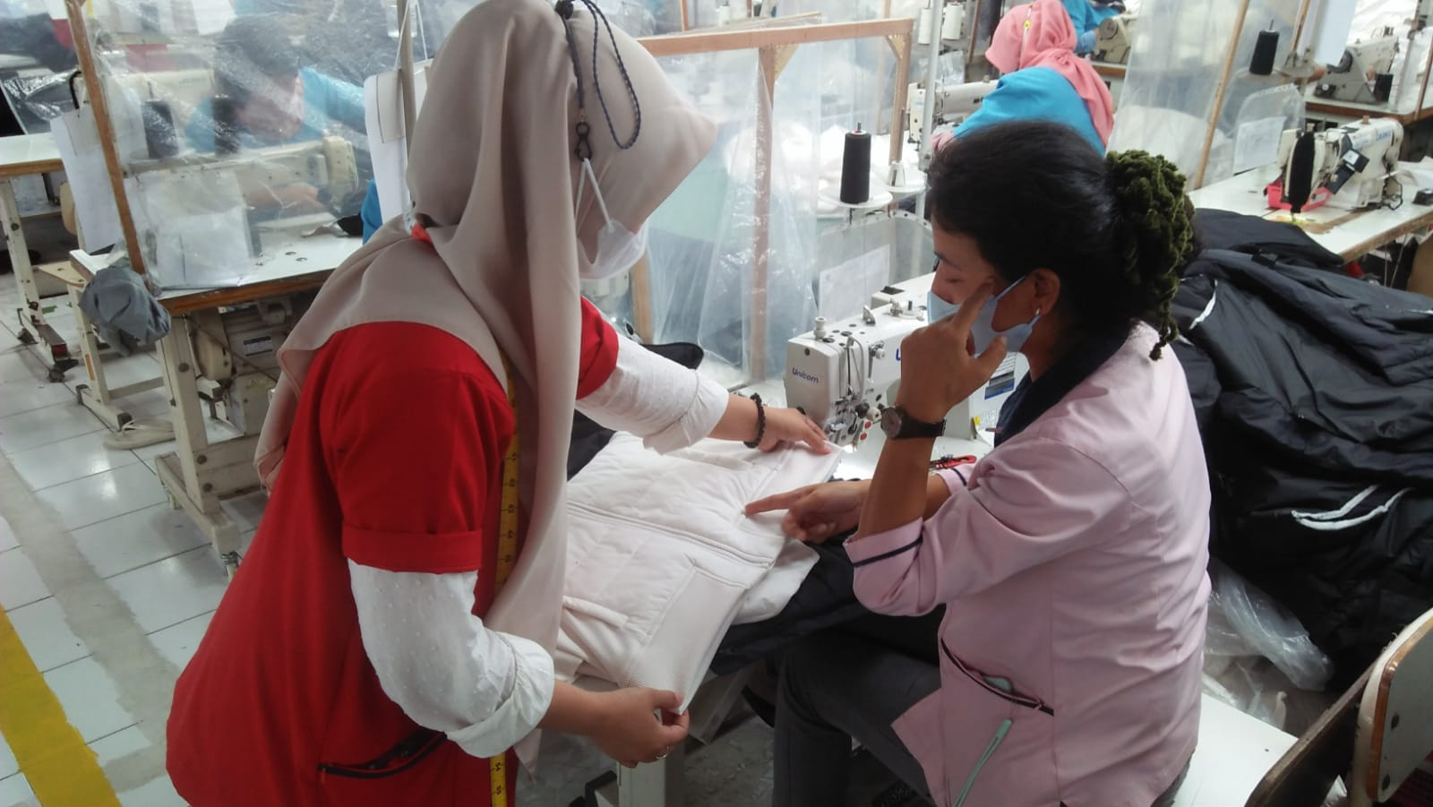
S.O.P Measurement
Follow up until the problem is resolved and record corrective action, then recheck the repaired garment and keep a report.
<Rejects Status, Wrong size on garments or over size speck>
<QC measurement complaining to the Supervisor for improving the garment>
<Compare size on the “size speck” form>
Garments size that out of tolerance are repaired and write down the results of the re-check in the empty row
  Garments with findings of defects or incorrect sizes should be looked for the problem, followed-up continuously until the problem is solved and do re-measure in the mattered point. (Garment dengan ukuran diluar toleransi harus diselidiki masalahnya, ditindaklanjuti sampai masalah selesai dan tercatat corrective action kemudian lakukan pengecekan ulang untuk garment yang telah diperbaiki dan keep report)
  After random measurements have been taken and the results are “OK,” proceed to the Endline QC process for visual QC checks, except for Athleta buyers, which are 100% key points. ( Setelah dilakukan pengukuran secara random dan hasil ukur ‘’OK’’ lanjut ke proses QC Endline untuk pengecekan QC Visual, kecuali untuk buyer Athleta 100% key point )

Slide 6
Thank you.
Right First Time
Notes:
Thank you for lis’ening, We’d like to open the discussion at the end of this presentation.

